Slide 1
The new Transform Designer available in BizTalk Services
BizTalk Innovation Day Norway
BizTalk Innovation Day Norway
Sandro Pereira
Senior Software Developer
Microsoft Integration MVP

Slide 2


Sandro Pereira
Senior Software Developer at DevScope
Microsoft Integration MVP since 2011
Writer of numerous articles for Portuguese eMagazine “Programar”
Author “Sandro Pereira BizTalk Blog” http://sandroaspbiztalkblog.wordpress.com
Member of “BizTalkAdminsblogging.com” and “BizTalk Brasil” community
Member NetPonto community
MSDN BizTalk Forums Moderator
TechNet Wiki author (Wiki Ninja)
TechNet Gallery, Code Gallery and CodePlex contributor
Public speaker
Technical Reviewer PACKT Publishing
BizTalk Server 2010 Cookbook (April 2012)

Slide 3
Agenda
Introduction to Microsoft Azure BizTalk Services Maps
Main differences between BizTalk Mapper and the Transform Designer (MABS)
Map Operations Available
Developing in the new Transform Designer
Introduction to the new Map Editor.
How to migrate BizTalk Maps to MABS Maps
How to apply some of the Mapper Patterns in this new editor.

Slide 4
Introduction to Microsoft Azure BizTalk Services Maps
Main differences between BizTalk Mapper and the Transform Designer (MABS)

Slide 5
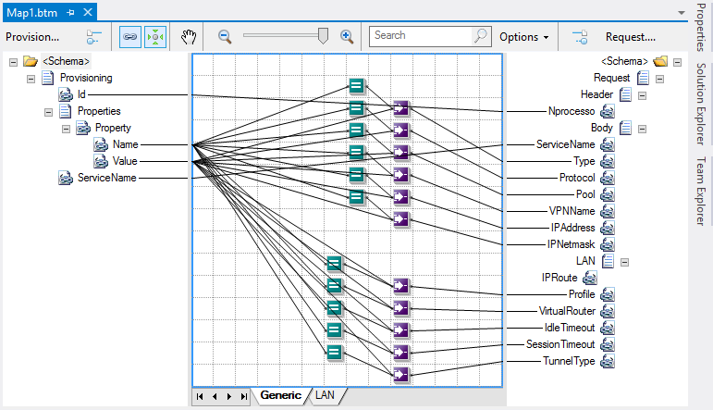
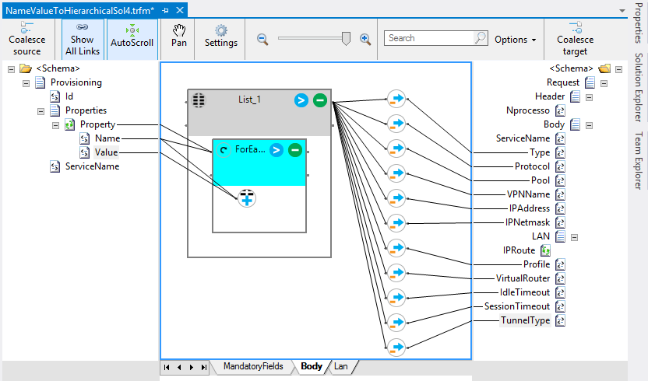
BizTalk Mapper vs Transform Designer
BizTalk Mapper
Functoids (Advanced, Conversion, Cumulative, Database, Date and Time, Logical, Mathematical, Scientific, String)
The transformation are created using XSLT
Transform Designer
Operations (String Operations, Loop Operations, List Operations, Cumulative Operations, Date / Time Operations, Miscellaneous Operations, Expressions)
The transformation are created using Extensible Application Markup Language (XAML)

Slide 6
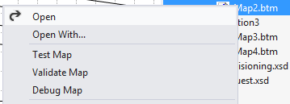
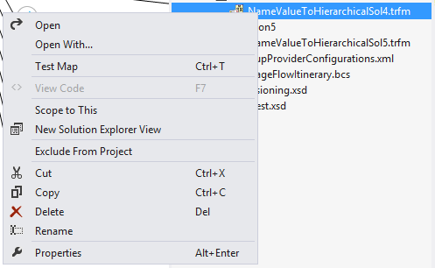
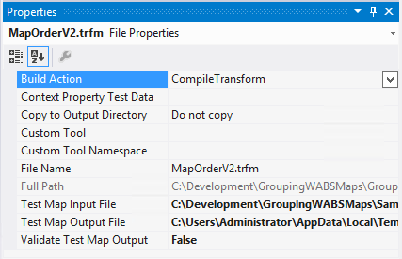
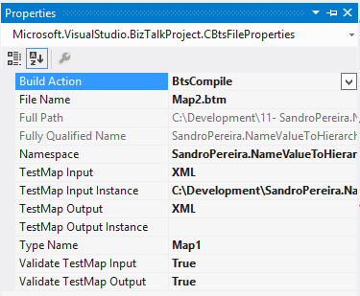
Operations available in maps at design time
Transform Designer
Limited operations
Only support testing (and validation while testing)
BizTalk Mapper
All functionalities at design time
Debugging, Testing and validate

Slide 7
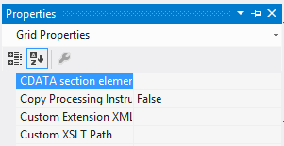
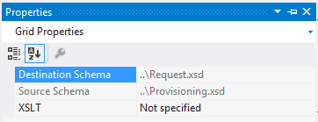
Extensibility
BizTalk Mapper
Importing Custom XSLT external code
Importing External .NET assembly
Transform Designer
Importing Custom XSLT external code
Note:
Custom Inline XSLT is not supported.
You can only use CSharp Scripting inside WABS maps.

Slide 8
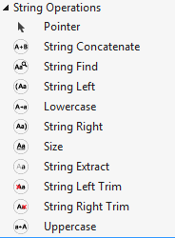
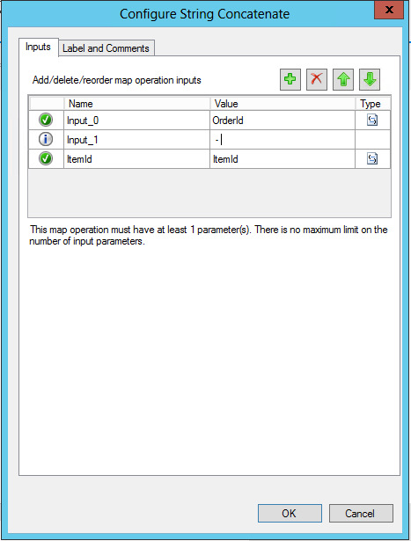
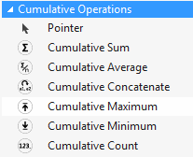
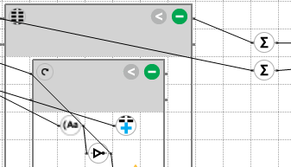
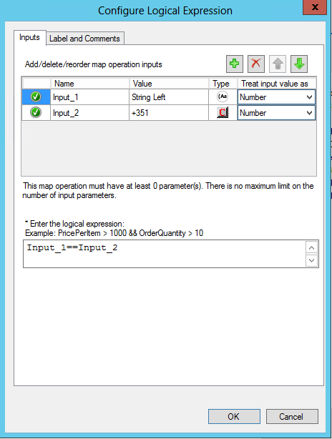
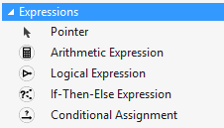
Map Operations
10 STRING OPERATIONS
String Concatenate / String Find / String Left / Lowercase / String Right / Size String Extract / String Left Trim / String Right Trim / Uppercase
http://msdn.microsoft.com/en-us/library/azure/hh689873.aspx
6 CUMULATIVE OPERATIONS
Cumulative Sum / Cumulative Average / Cumulative Concatenate / Cumulative Maximum
Cumulative Minimum / Cumulative Count
http://msdn.microsoft.com/en-us/library/azure/hh689770.aspx
4 EXPRESSIONS OPERATIONS
Arithmetic Expression / Logical Expression / If-Then-Else Expression Conditional Assignment
http://msdn.microsoft.com/en-us/library/azure/hh689810.aspx
Notes:
Cumulative Sum - Returns the accumulated value of a record.
Cumulative Average - Returns the accumulated average value of a record
Cumulative Concatenate- Concatenate strings from a record in the source schema to a single record in the target schema.
Cumulative Maximum - Returns the accumulated maximum value of a record.
Cumulative Minimum - Returns the accumulated minimum value of a record.
Cumulative Count - Returns the number of times a specified repeating structure or value occurs.
Arithmetic Expression - Evaluates a mathematical expression using inputs and constants. Arithmetic Expressions consists of the following operators: Addition, Subtraction, Multiplication, Division, Modulo, Absolute Value, Maximum, Minimum, Round, Square Root
Logical Expression - Evaluates a condition and outputs the Boolean value of the evaluation. Logical Expression consists of the following operators: Relational Operators: >, <, >=, <=, ==, !=; Logical Negation (!), Conditional AND (&&), Conditional OR (||)
If-Then-Else Expression - Evaluates a statement that results in one of two possible outputs
Conditional Assignment - Returns a value from one of two input parameters. If the first input value is True, then a node is created in the output document with the second input value. If the first input value is False, then the corresponding node is not created in the output document.

Slide 9
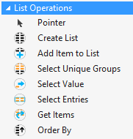
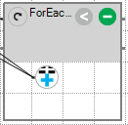
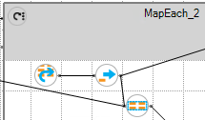
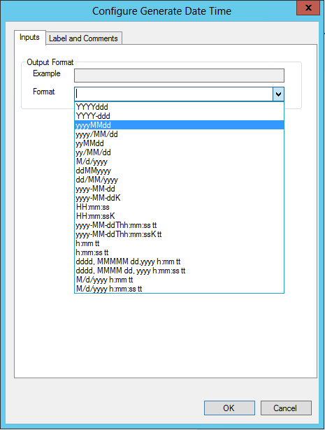
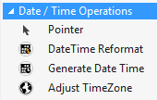
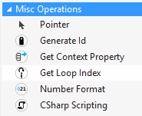
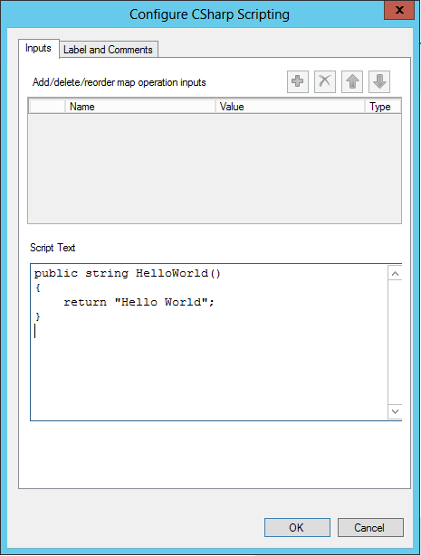
Map Operations
7 LIST OPERATIONS
Create List / Add Item to List / Select Unique Groups / Select Value / Select Entries
Get Items / Order By
http://msdn.microsoft.com/en-us/library/azure/hh689871.aspx
3 DATE / TIME OPERATIONS
DateTime Reformat / Generate Date Time / Adjust TimeZone
http://msdn.microsoft.com/en-us/library/azure/hh689903.aspx
5 MISCELLANEOUS OPERATIONS
Generate ID / Get Context Property / Get Loop Index Value / Number Format CSharp Scripting
http://msdn.microsoft.com/en-us/library/azure/hh689897.aspx
Notes:
Get Context Property
Used to access the property values.
Transforms are executed inside a bridge. When a bridge receives an incoming message, it builds a property-bag corresponding to the actual message body. The Get Context Property Map Operation can access these property values from within a Transform.
Create List - Creates and initializes a List.
Add Item to List - Adds an item to the list. Use only in the container of the Create List Map Operation.
Select Unique Groups - Generates groups from a list. Each group is identified by a unique value of the selected members. The selected members for the unique key for each group.
Select Value - Select the first item In a List. If a condition is specified, the first item in the list matching the condition is selected.
Select Entries - Filters a List.
Get Items - Used in a ForEach or MapEach Loop. Gets the item in the list of the current iteration. When iterating over Unique Groups generated from a list, it returns the current group's items.
Order By - Orders items in a List.
DateTime Reformat - Reformats a date/time value.
Generate Date Time - Generates the current Date/Time.
Adjust TimeZone - Converts a date/time value to a different time zone. An Input Date is parsed and then converted from the Input time zone to the Output time zone.

Slide 10
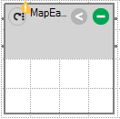
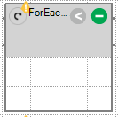
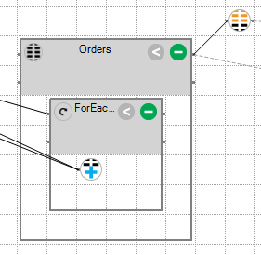
Map Operations - Loop
MapEach Loop
Loops over a repeating record in the source document. Relationships defined within the MapEach Loop container scope are evaluated at each iteration of the loop. Each iteration of the loop produces an instance of the repeating record in the target document.
ForEach Loop
Loops over a repeating record in the source document. Relationships defined within the ForEach Loop container are evaluated at each iteration of the loop. There is no record in the target document and there are no output links.
ForEach is typically used on List
http://msdn.microsoft.com/en-us/library/azure/hh689873.aspx

Slide 11
Developing in the new Transform Designer
Introduction to the new Map Editor. How to migrate BizTalk Maps to MABS Maps and how to apply some of the Mapper Patterns in this new editor

Slide 12
Migrate
Operations
Testing
Demos
MABS Maps an introduction to the new Map Editor. How to migrate BizTalk Maps to MABS Maps and how to apply some of the Mapper Patterns in this new editor.

Slide 13






Questions?
sandro.pereira@devscope.net
linkedin.com/in/sandropereira
@sandro_asp
sandroaspbiztalkblog.wordpress.com
www.devscope.net

